Slide 1

VISUAL SLAM "Benchmarking study on performance comparison between Oriented FAST & rotated BRIEF SLAM (ORB-SLAM) and OpenvSLAM"
CSCI 508
Ramprasad Rajagopalan
Bhuvan Tej Kanigiri
Notes:
1

Slide 2
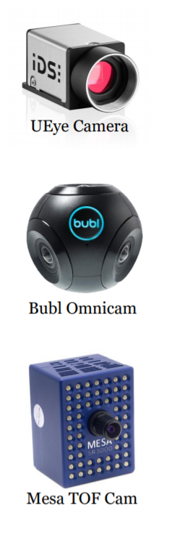
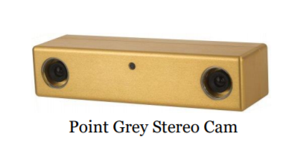
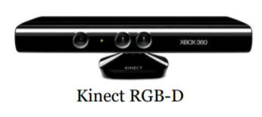
Introduction
What is Visual Odometry (VO) ?
vSLAM = VO + global map optimization
What is Visual SLAM ?
It is process of determining the position and orientation
of a camera with respect to its surroundings, while
simultaneously mapping the environment
around that camera using image sequences.
“It was first Introduced for planetary rovers
operating on Mars - Moravec 1980”
Camera Types:
Passive
Active
Hybrid
Image courtesy : University of Toronto

Slide 3
Introduction
Scene modeling: Two ways (1) Sfm (2)Visual SLAM
Sfm: Prebuilt map: 3D reconstruction via Batch processing.
VSLAM: Real-time 3D mapping
State of the art algorithms in vSLAM
Feature based: MonoSLAM, PTAM
ORB-SLAM, openVSLAM
Direct methods: LSD-SLAM, SVO-DSO
RGBD Methods: Kinect Fusion, SLAM++
Image courtesy : University of Toronto

Slide 4
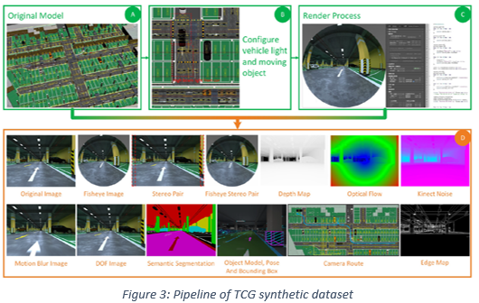
Related work
Dataset evaluations research:
Real world data:
Sturm et al. [4] presented a novel benchmarking criterion for evaluating the performance of RGB-D vSLAM systems
Geiger et al. [11], KITTI, establishes benchmarks constituting of stereo data and optical flow image pairs with odometry sequences in cluttered mid-size city, suburban areas and freeways.
Engel et al. [6] provided novel mathematical implementation of photometrically calibrated benchmark for vSLAM systems using monocular camera
Rebert et al. [14] addresses methodology for obtaining ground truth data based on placing fiducial markers in an environment and estimating camera pose.
Synthetic datasets:
Martull et al. [4] focused on developing the dataset for stereo matching
and camera tracking evaluation using realistic CG rendering techniques.

Slide 5
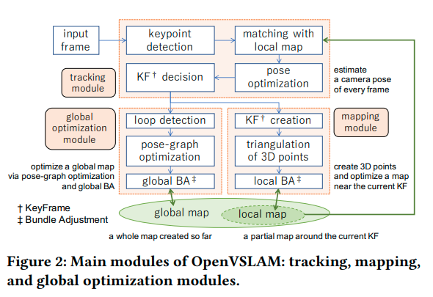

Workflow : OpenvSLAM
OpenvSLAM
Key point: FAST algorithm
Descriptors Method: Binary Vector
Main Contribution:
Flexibility on camera models
Storage of maps
Implementation:
Main implemented in C++
Eigen for matrix calculation
Opencv for I/O operations of images
General Graph Optimization(g2o) for map optimization.
source : openvslam paper[3]
Notes:
,.

Slide 6
Workflow : OpenvSLAM
OpenvSLAM
Key point: FAST algorithm
Descriptors Method: Binary Vector
Goal: To minimize the reprojection error
Tracking
Mapping
Global Optimization
Bundle Adjustment:
Reduces reprojection error
Optimizes intrinsic & extrinsic matrix
source : openvslam paper[3]

Slide 7
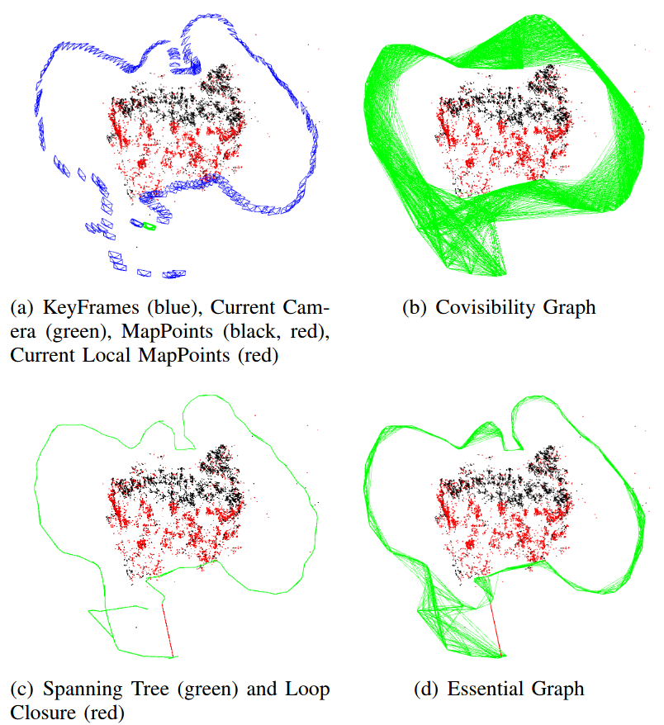
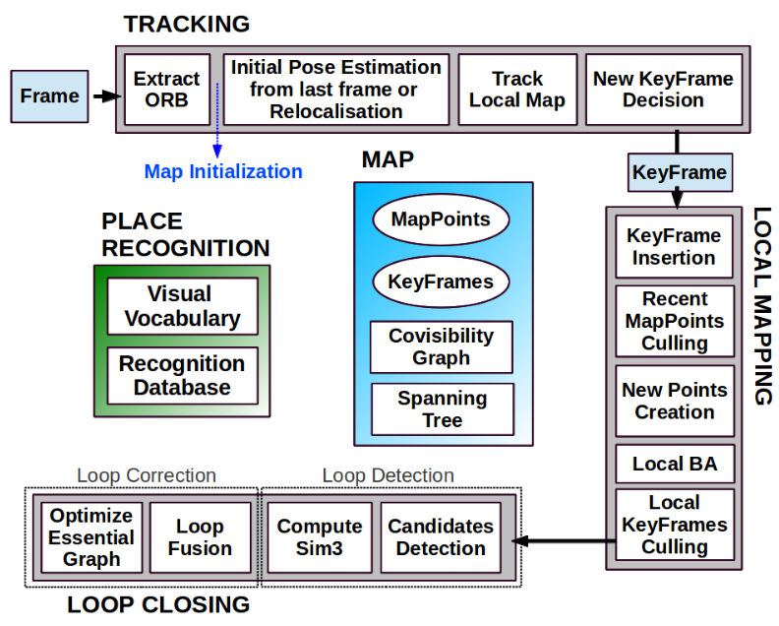
Workflow : ORB-SLAM
[2]
left & right Images source : ORB_SLAM paper[2]
Use of same features for tracking, mapping, relocalisation and loop closing for efficient real-time performance without GPU

Slide 8
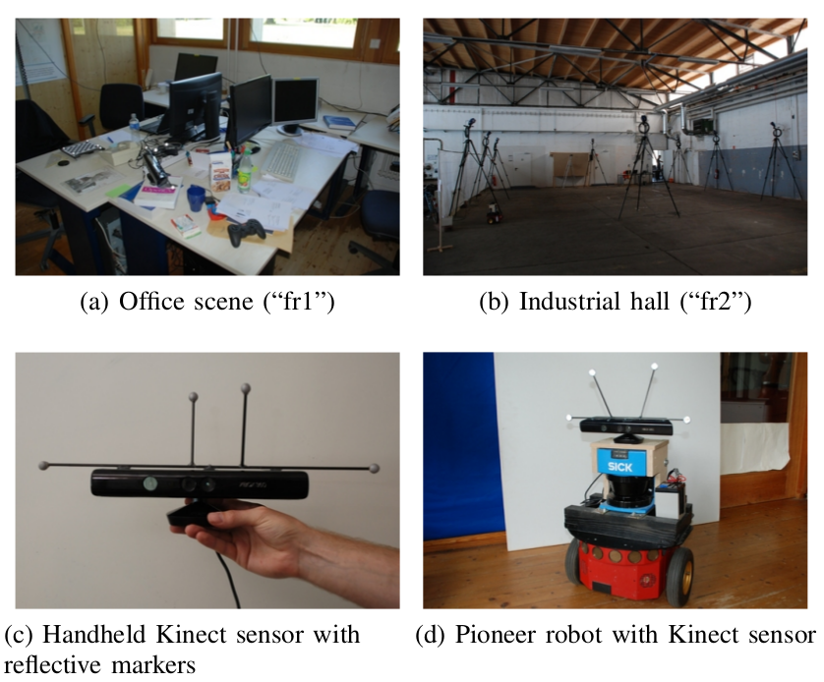
Generic dataset: TUM RGB-D
DATASET | Sensor | Image resolution | Ground-Truth
TUM RGB-D | Microsoft Kinect - RGB-D Accelerometer | 640 x 480 px | Motion capture
Datasets used : freiburg1_desk, freiburg2_pioneer_360
Image source Sturm paper N[7]
Notes:
OpenvSLAM is experimented on three types of datasets
Standard datasets
Evaluation on: Paper’s dataset
EuRoC MAV Dataset
KITTI Odometry Dataset
Evaluation on: Other datasets
TUM RGBD dataset
Own dataset:
Performed on COZMO &VECTOR

Slide 9
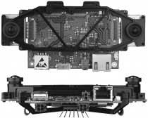
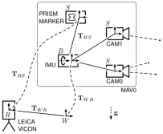
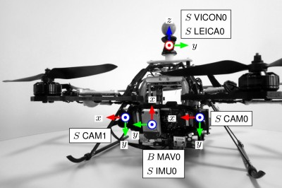
Generic dataset: EuRoC
DATASET | Sensor | Image resolution | Ground-Truth
EuRoC | Stereo camera MEMS IMU | 752 x 480 px | Vicon motion capture system (6D pose) Leica MS50 laser tracker (3D position) Leica MS50 3D Structure scan
Datasets used: Machine Hall 01 , Machine Hall 04 - Indoor Factory ,Vicon room 101, Vicon room 103
An Asctec Firefly hex-rotor
Image source Euroc [6]
Notes:
OpenvSLAM is experimented on three types of datasets
Standard datasets
Evaluation on: Paper’s dataset
EuRoC MAV Dataset
KITTI Odometry Dataset
Evaluation on: Other datasets
TUM RGBD dataset
Own dataset:
Performed on COZMO &VECTOR

Slide 10
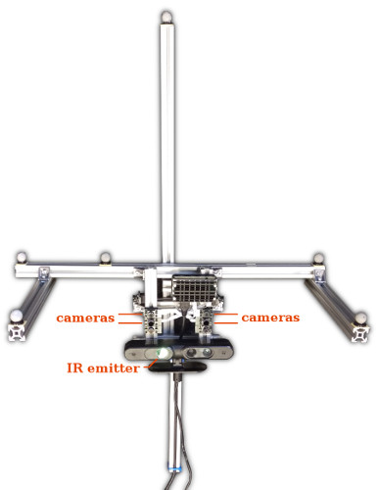
Generic dataset: ETH3D - comparison
DATASET | Sensor | Image resolution | Ground-Truth
ETH3D | Stereo camera Two infrared cameras to estimate depth IMU | 739 x 458 px | Structure-from-Motion. Vicon motion capture
Datasets used : cables_1, large_loop_1
Image source : eth3D[8]
Notes:
OpenvSLAM is experimented on three types of datasets
Standard datasets
Evaluation on: Paper’s dataset
EuRoC MAV Dataset
KITTI Odometry Dataset
Evaluation on: Other datasets
TUM RGBD dataset
Own dataset:
Performed on COZMO &VECTOR

Slide 11
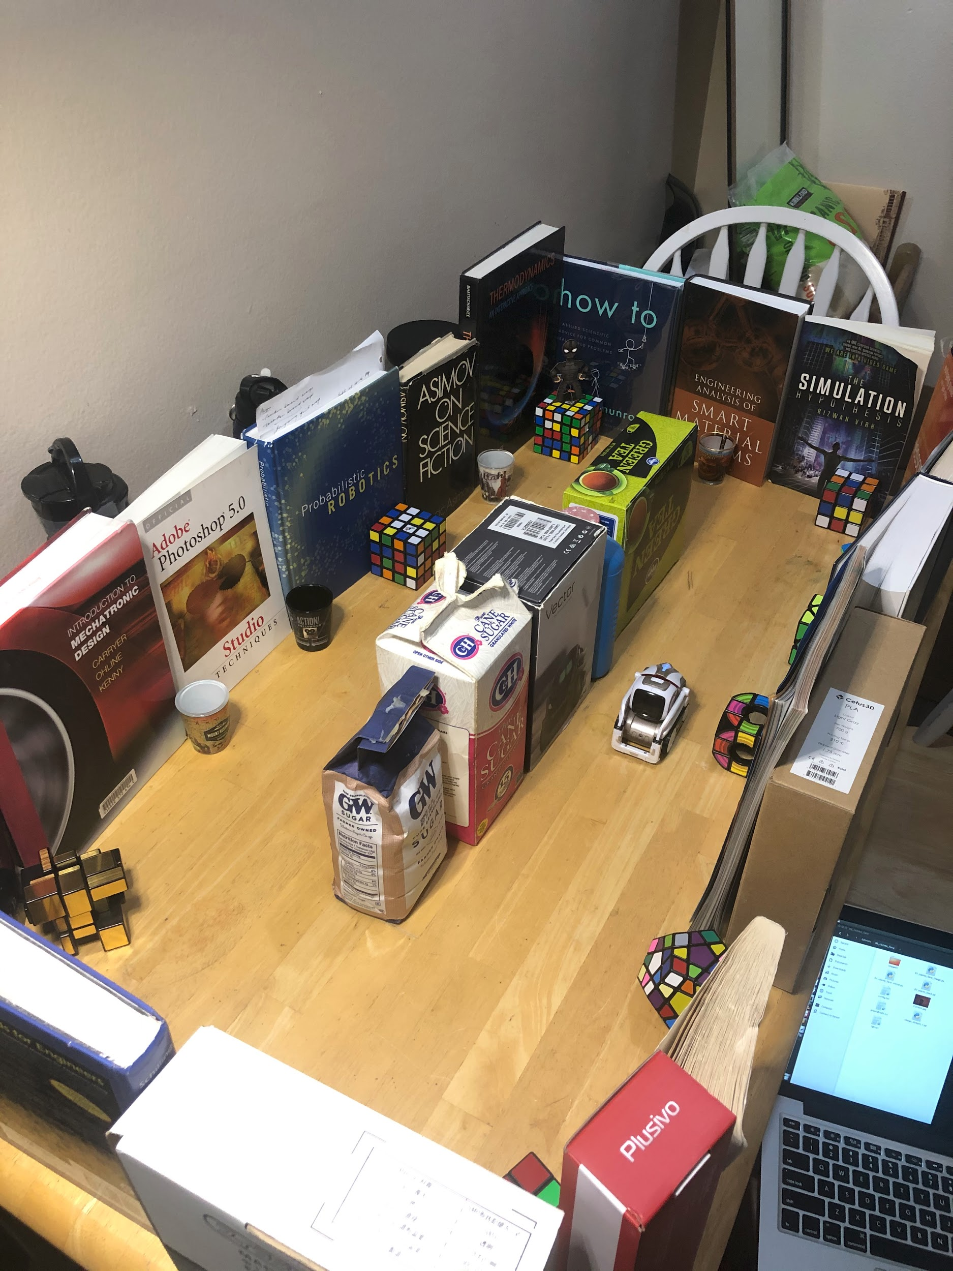
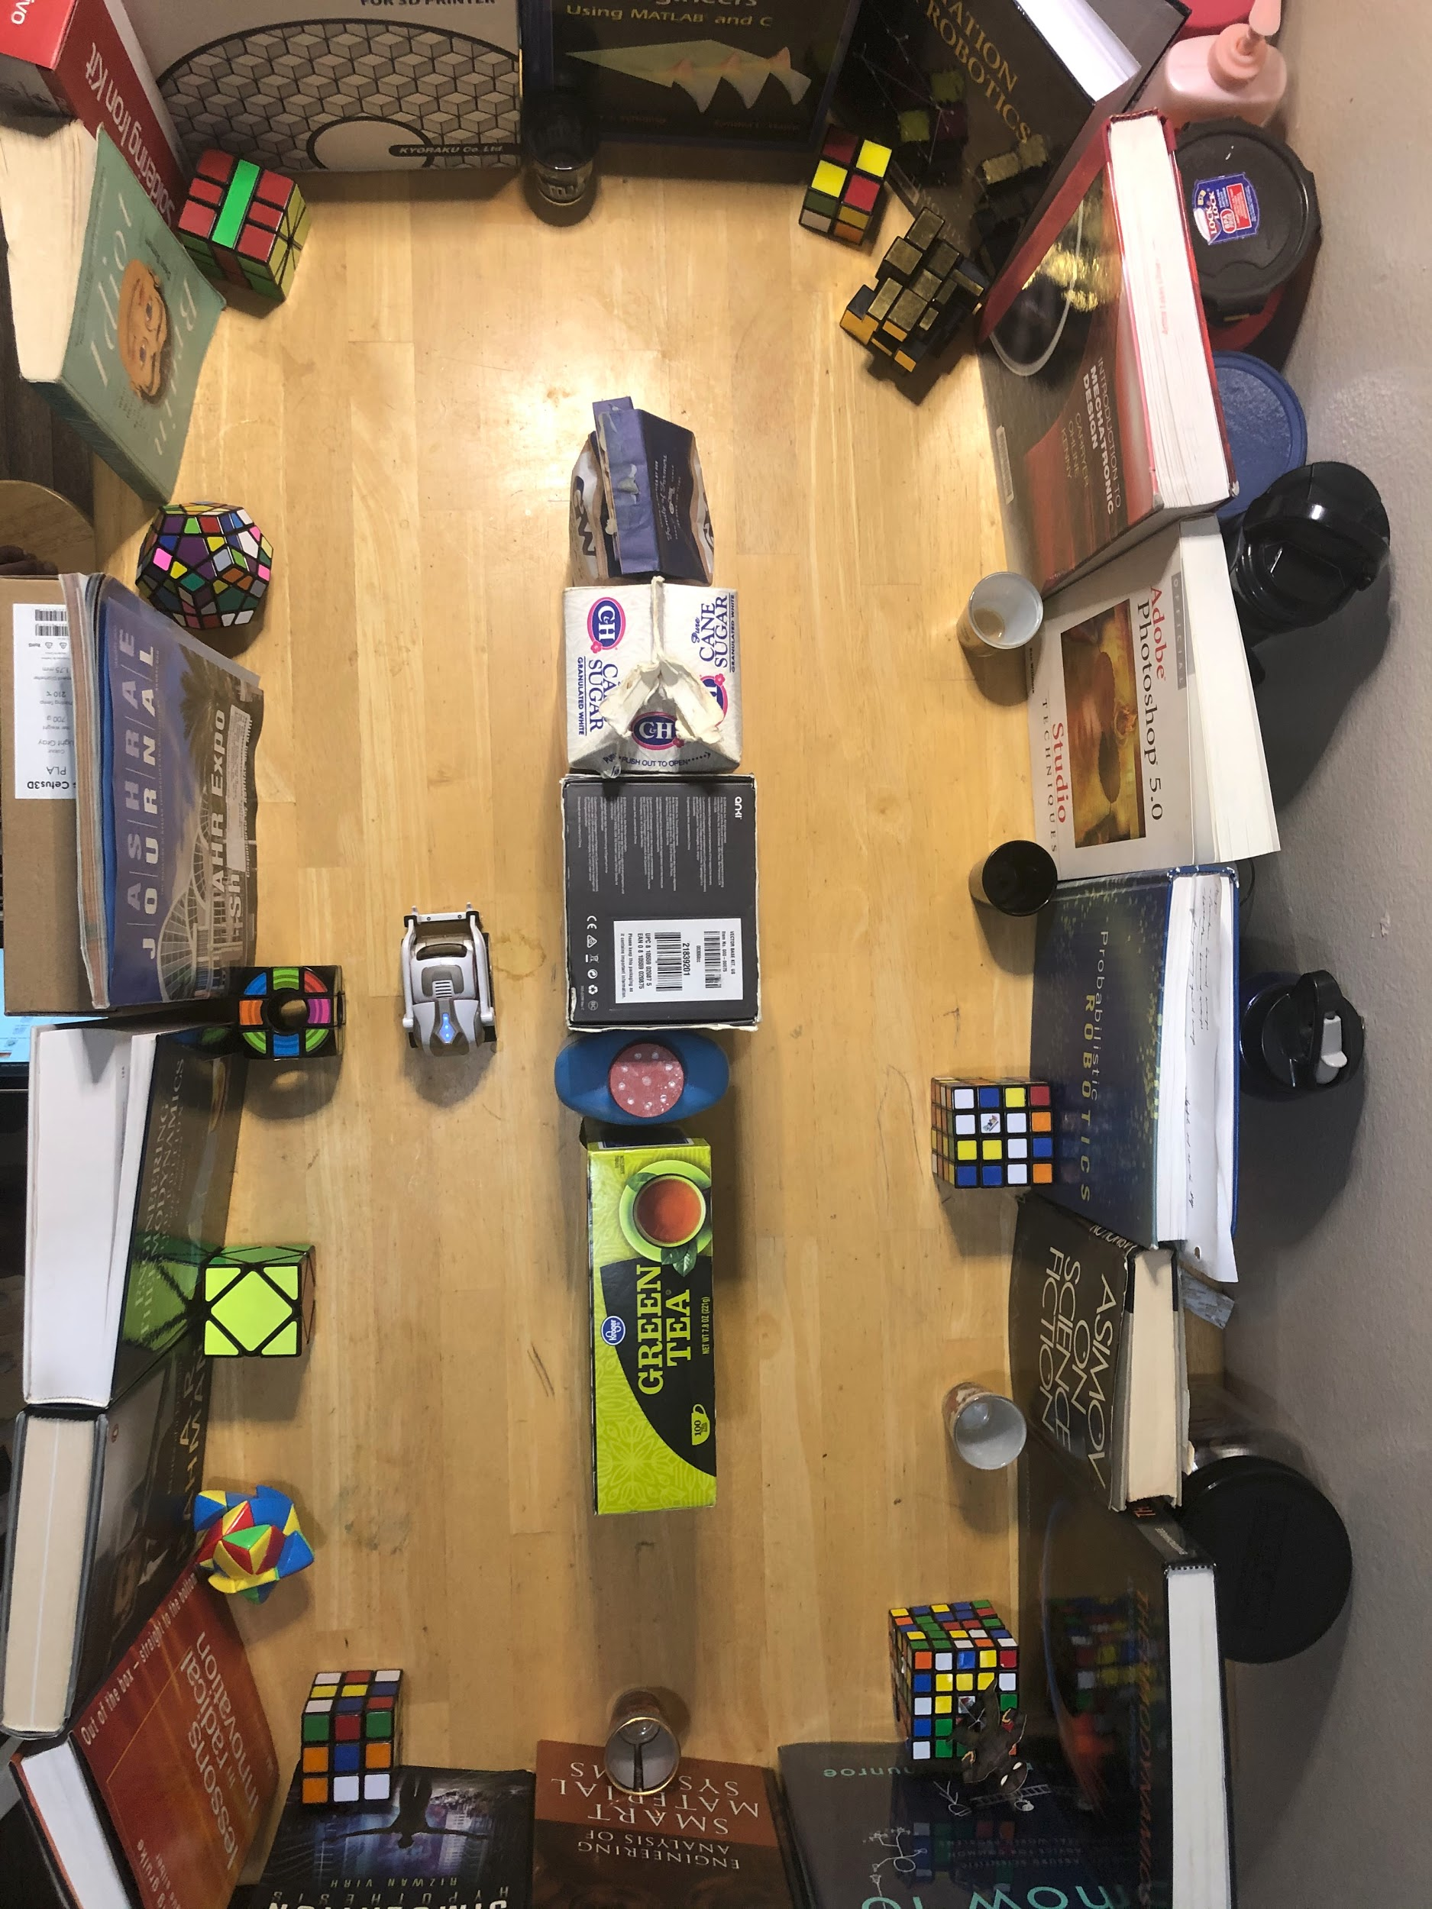
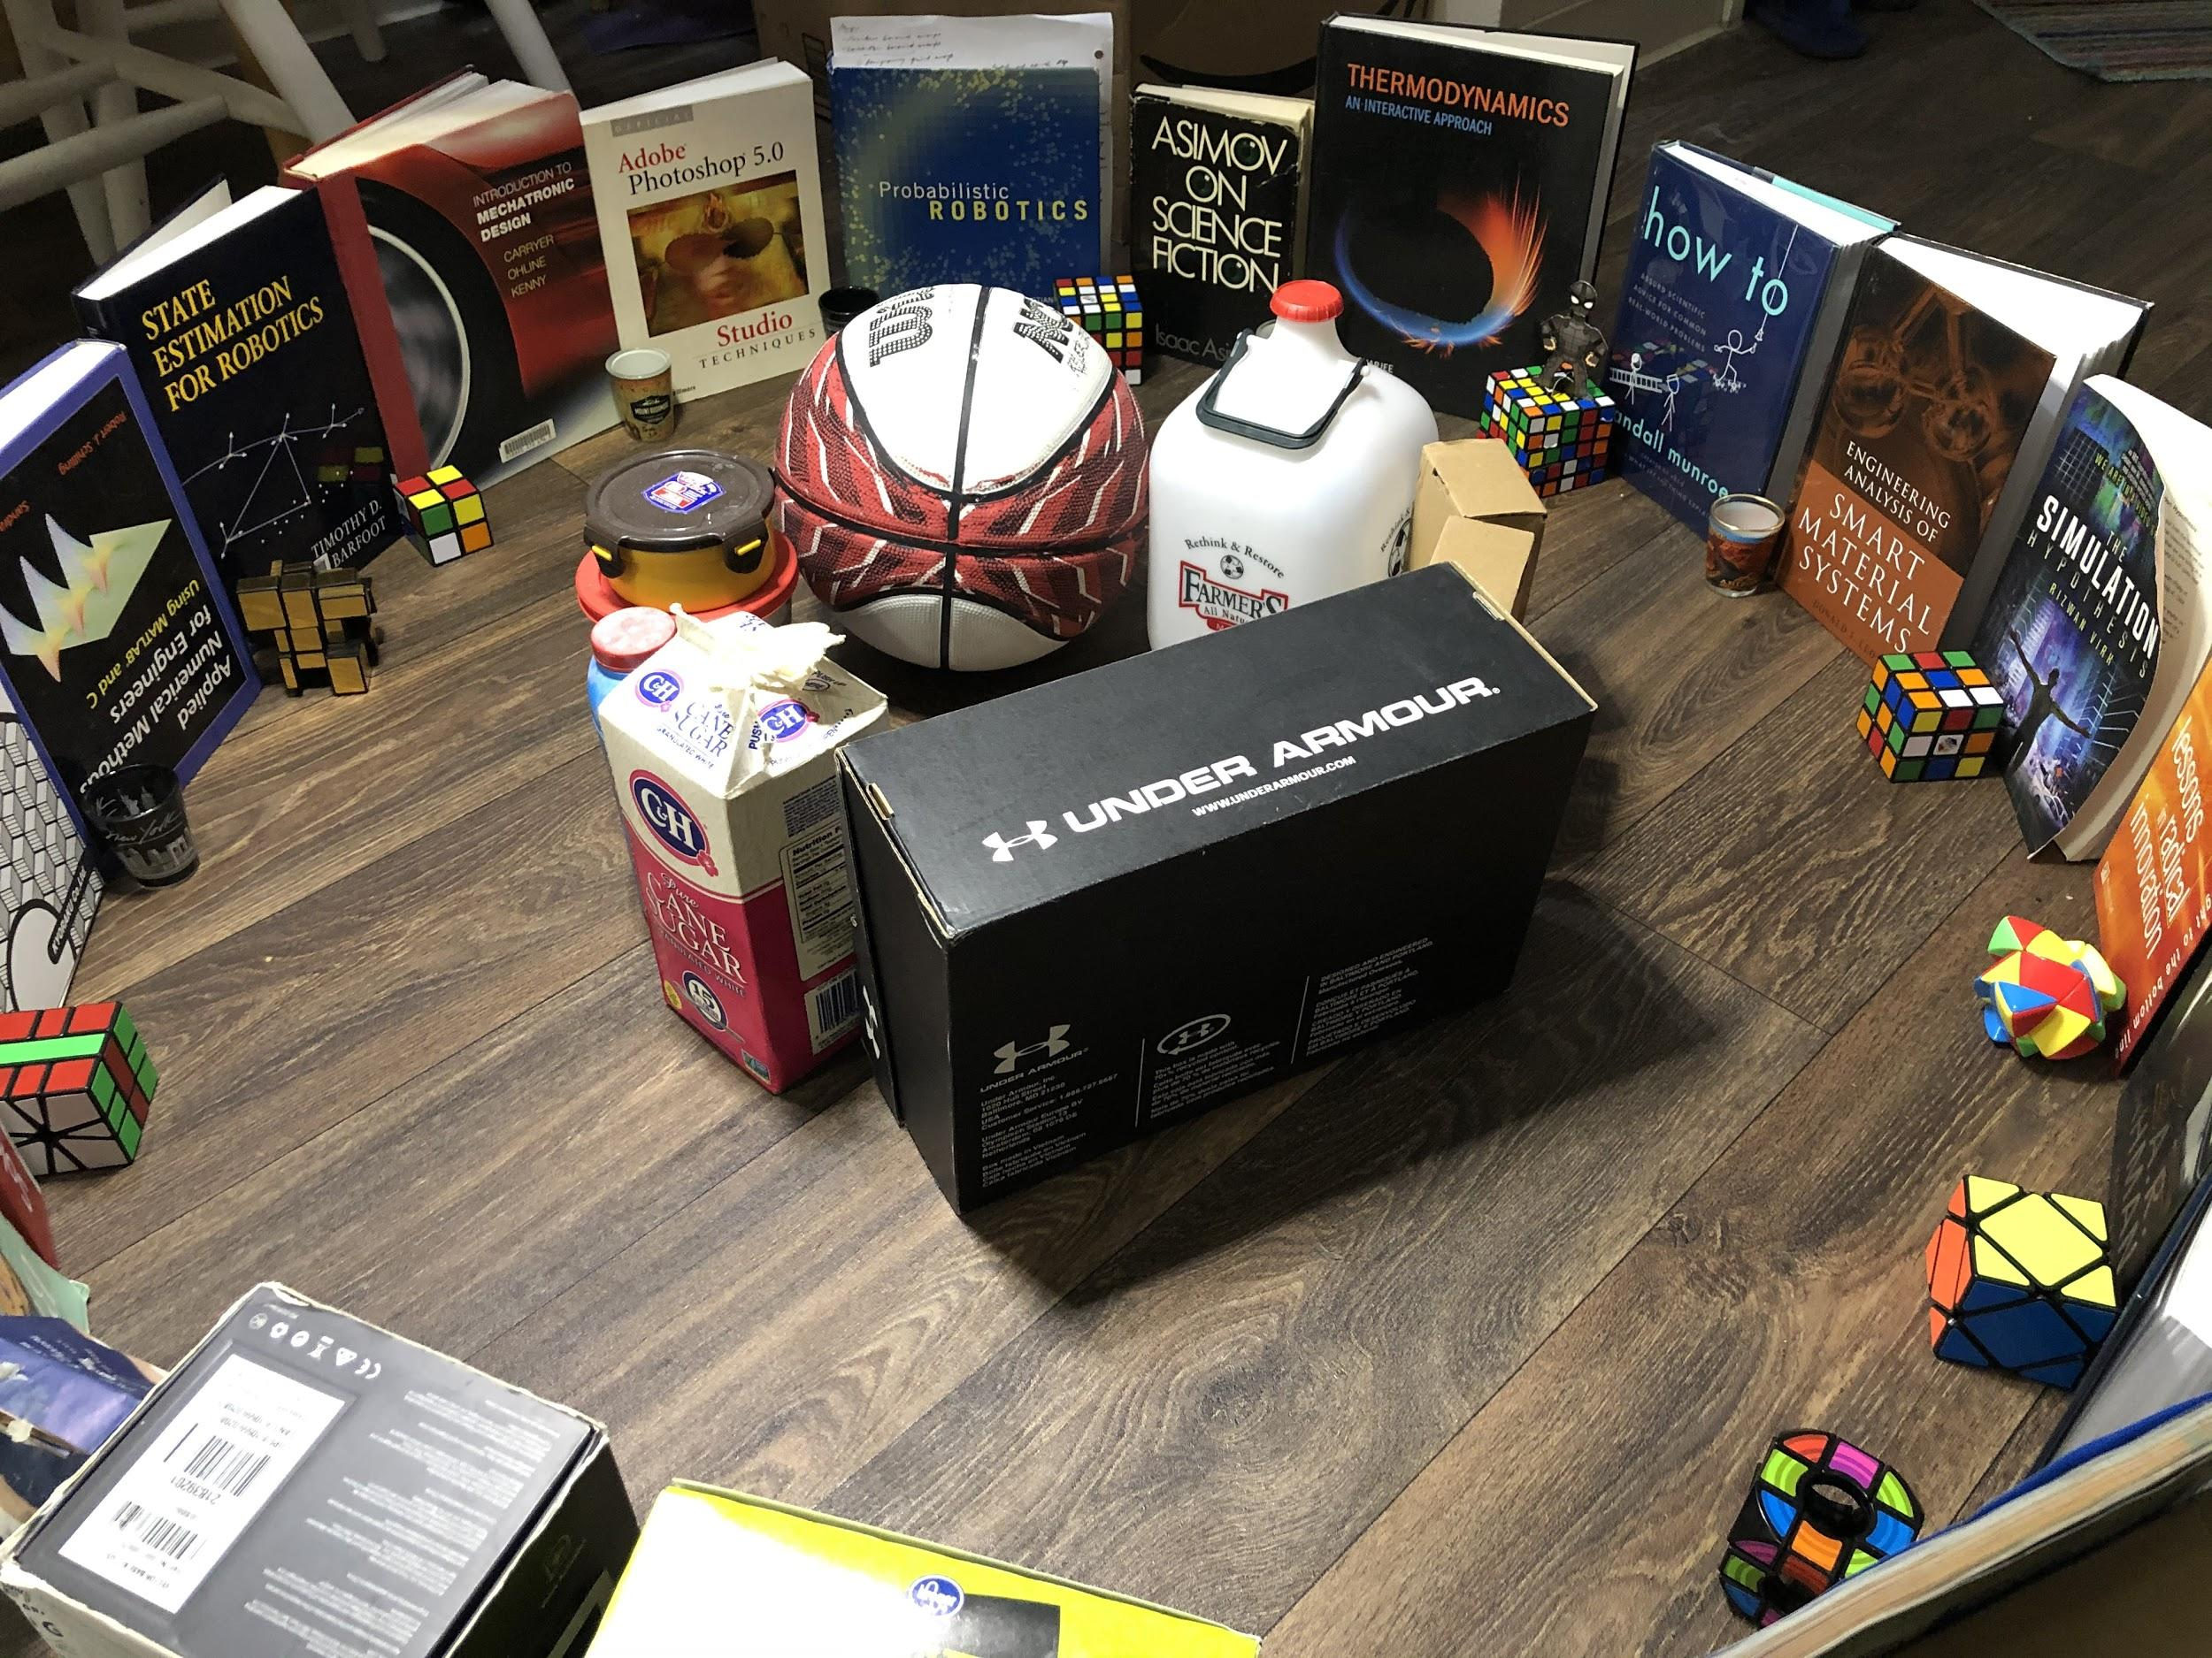
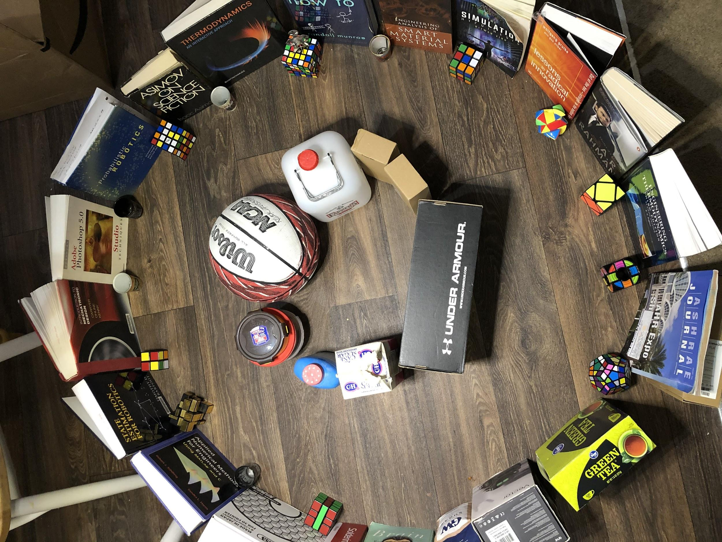
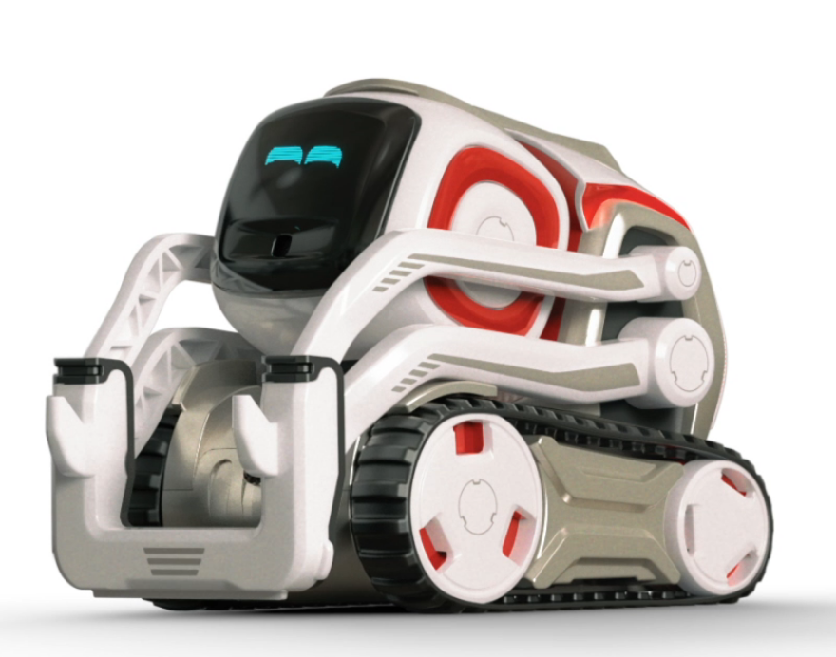
Custom dataset
DATASET | Sensor | Image resolution | Ground-Truth
COZMO ROBOT | Monocular perspective camera and IMU | 320 x 240 px | Inertial pose estimation from SDK
IPHONE | Monocular perspective camera | 1920 x 1080 px | NA
Notes:
OpenvSLAM is experimented on three types of datasets
Standard datasets
Evaluation on: Paper’s dataset
EuRoC MAV Dataset
KITTI Odometry Dataset
Evaluation on: Other datasets
TUM RGBD dataset
Own dataset:
Performed on COZMO &VECTOR

Slide 12
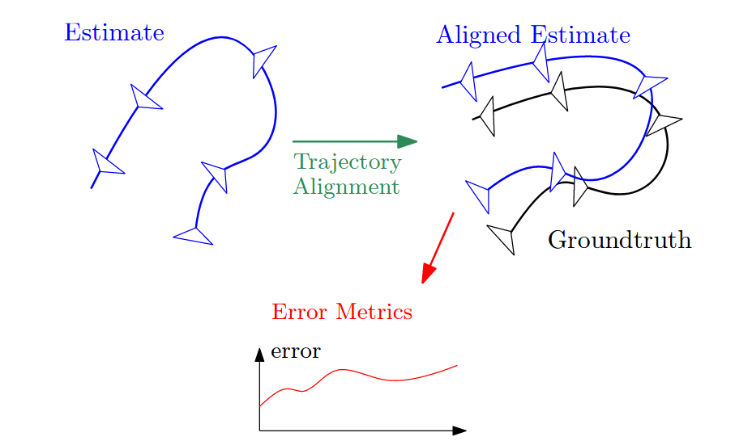
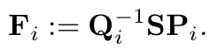
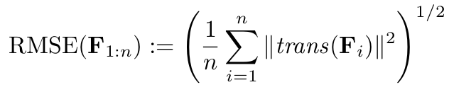
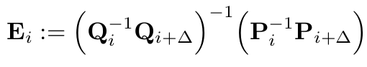
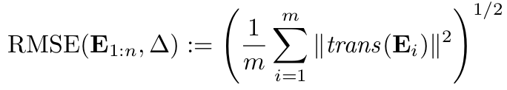
Evaluation metrics
Absolute trajectory error (ATE) [4]:
Comparing absolute distance for global consistency
Relative pose error (RPE) [4]:
[9]
evo [10] - Python based SLAM and odometry evaluation tool
Local accuracy over fixed time interval
Image source 9] Zichao Zhang, Davide Scaramuzza
Notes:
OpenvSLAM is experimented on three types of datasets
Standard datasets
Evaluation on: Paper’s dataset
EuRoC MAV Dataset
KITTI Odometry Dataset
Evaluation on: Other datasets
TUM RGBD dataset
Own dataset:
Performed on COZMO &VECTOR

Slide 13
Experimental results and limitation
Dataset | Sequence | Absolute trajectory error (ATE) - RMSE |  |  |  | Relative pose error (RPE) - RMSE |  |  |  | Tracking lost
 |  | Mono |  | Stereo/RGB-D |  | Mono |  | Stereo/RGB-D
 |  | ORB-SLAM | OpenvSLAM | ORB-SLAM | OpenvSLAM | ORB-SLAM | OpenvSLAM | ORB-SLAM | OpenvSLAM
TUM RGB-D | fr1_desk | 0.013 | 0.017765 | 0.01613 | 0.016178 | 0.0165 | 0.022837 | 0.010363 | 0.00973 | 1
 | fr2_pioneer_360 | 0.01393 | 0.09334 | 0.048189 | 0.04854 | 0.018187 | 0.041731 | 0.01977 | 0.014827 | 5
EuRoC | MH_01_easy | 0.04458 | 0.04227 | 0.043726 | 0.047247 | 0.580733 | 0.53282 | 0.02802 | 0.33759 | -
 | MH_04_difficult | 0.071022 | 0.22107 | 0.129314 | 0.06544 | 0.780134 | 0.7457 | 0.069968 | 0.49496 | -
 | V1_01_easy | 0.09555 | 0.09541 | 0.08746 | 0.09326 | 0.61214 | 0.6403 | 0.02598 | 0.46893 | -
 | V1_03_difficult | 0.07064 | 0.06775 | 0.08548 | 0.07313 | 0.5459 | 0.4834 | 0.05176 | 0.4326 | 6
ETH3D | cables_1 | - | 0.2483 | - | - | - | 0.2483 | - | - | 1
 | large_loop_1 | - | No loop closure | - | - | - | No loop closure | - | - | 2
COZMO | circle_cam | 0.74621 | - | - | - | 1.8234 | - | - | - | 5
 | square_cam | 0.9011 | 0.8291 | - | - | 0.09121 | 0.2817 | - | - | 3

Slide 14
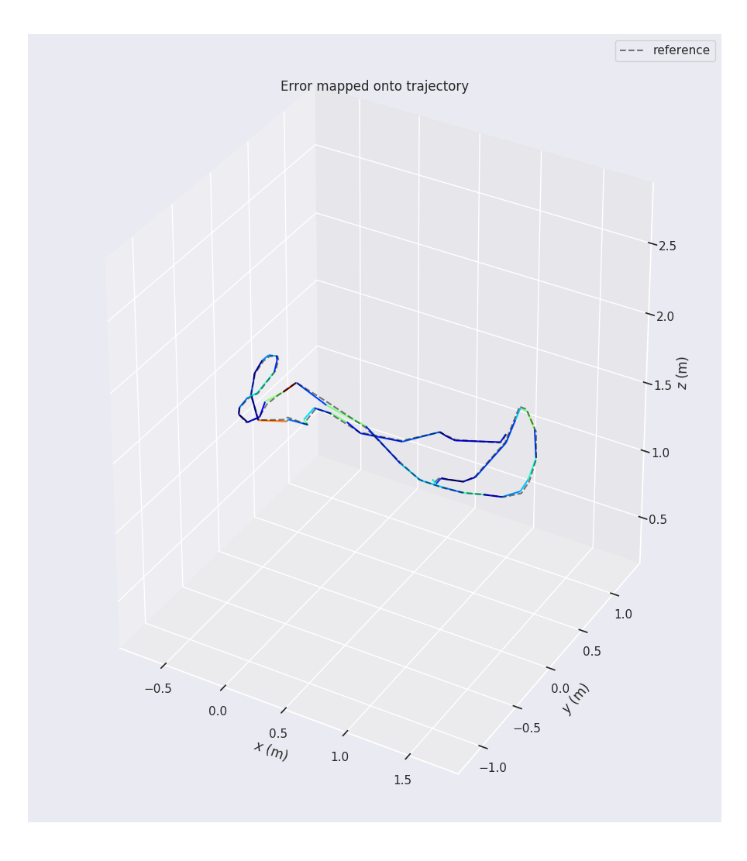
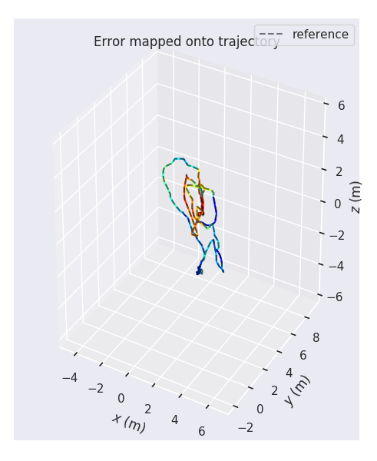
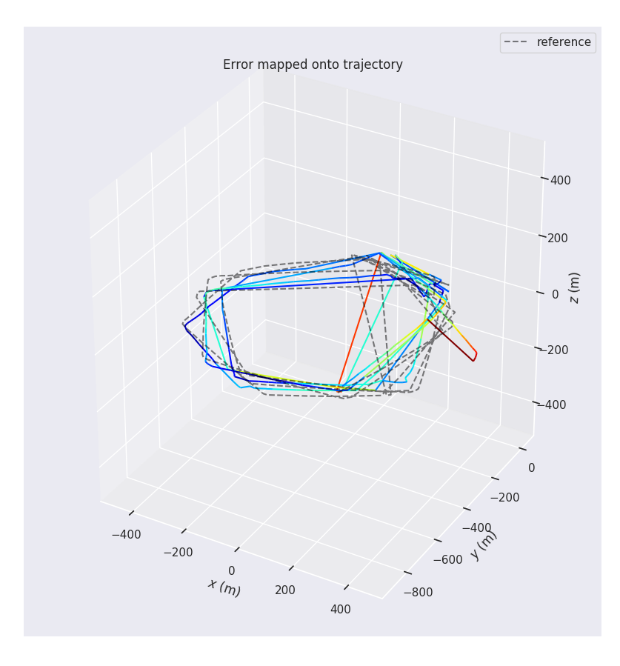
Plots
TUM RGB-D fr1_desk
EuRoC MH_01_easy
COZMO circle_cam

Slide 15
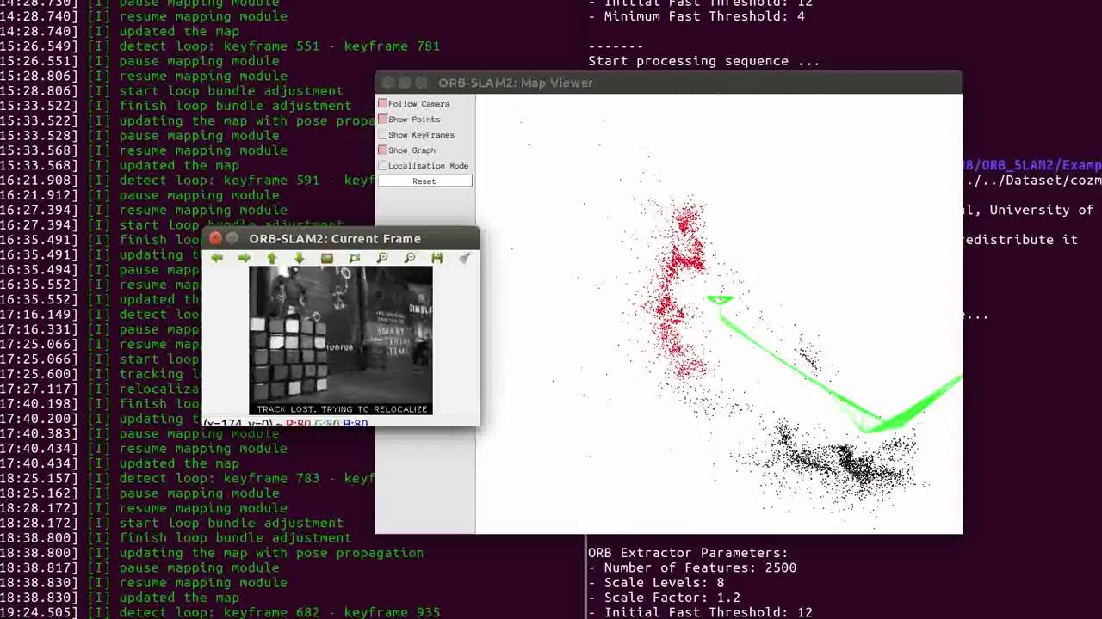

Slide 16
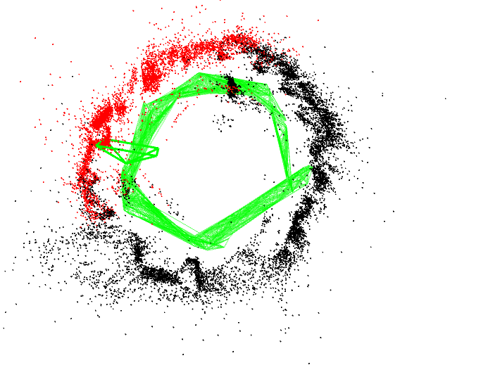
COZMO custom dataset - SLAM
Total time of sequence - 600s, No. of images in the sequence - 14452 and mean tracking time - 71.9611ms
Map initialised with 140 points

Slide 17
Future work
Collect datasets on stereo/RGB-D
Implement fiducial tag ground truth approximation for COZMO
Sfm for mobile phone dataset collection
It will be worthwhile to explore option of obtaining real-world dataset with easy or absence of ground truth estimates.

Slide 18

References
[1] T. Taketomi, H. Uchiyama, and S. Ikeda, “Visual slam algorithms: a survey from 2010 to 2016,”IPSJ Transactions on Computer Vision and Applications, vol. 9,no. 1, p. 16, 2017.
[2] Raúl Mur-Artal, J. M. M. Montiel and Juan D. Tardós. ORB-SLAM: A Versatile and Accurate Monocular SLAM System. IEEE Transactions on Robotics, vol. 31, no. 5, pp. 1147-1163, 2015. (2015 IEEE Transactions on Robotics Best Paper Award).
[3] S. Sumikura, M. Shibuya, and K. Sakurada, “Openvslam: A versatile visual slam framework,” inProceedings of the 27th ACM International Conference on Multimedia, 2019, pp. 2292–2295.
[4] J. Sturm, N. Engelhard, F. Endres, W. Burgard, and D. Cremers, “A benchmark for the evaluation of rgb-dslam systems,” in 2012 IEEE/RSJ International Conference on Intelligent Robots and Systems.IEEE, 2012,pp. 573–580.
[5] C. Sweeney, L. Kneip, T. H ̈ollerer, and M. Turk, “Computing similarity transformations from only image correspondences,” in 2015 IEEE Conference on Computer Vision and Pattern Recognition (CVPR), 2015,pp. 3305–3313.
[6] Burri, M. et al. (2016) ‘The EuRoC micro aerial vehicle datasets’, The International Journal of Robotics Research, 35(10), pp. 1157–1163. doi: 10.1177/0278364915620033.
[7] . Sturm, N. Engelhard, F. Endres, W. Burgard and D. Cremers,A Benchmark for the Evaluation of RGB-D SLAM Systems,Proc. of the International Conference on Intelligent Robot Systems (IROS), Oct. 2012.
[8] T. Schöps, T. Sattler, M. Pollefeys, "BAD SLAM: Bundle Adjusted Direct RGB-D SLAM", Conference on Computer Vision and Pattern Recognition (CVPR), 2019.
[9] Zichao Zhang, Davide Scaramuzza: A Tutorial on Quantitative Trajectory Evaluation for Visual(-Inertial) Odometry, IEEE/RSJ Int. Conf. Intell. Robot. Syst. (IROS), 2018
[10] github.com/MichaelGrupp/evo
[11] Geiger, A., Lenz, P. and Urtasun, R., 2012, June. Are we ready for autonomous driving? the KITTI vision benchmark suite. In 2012 IEEE Conference on Computer Vision and Pattern Recognition (pp. 3354-3361). IEEE.
[12] Engel, J., Usenko, V. and Cremers, D., 2016. A photometrically calibrated benchmark for monocular visual odometry. arXiv preprint arXiv:1607.02555
[13] Rebert, M., Monnin, D., Bazeille, S. and Cudel, C., 2019, July. A review of the dataset available for visual odometry. In Fourteenth International Conference on Quality Control by Artificial Vision (Vol. 11172, p. 111720W). International Society for Optics and Photonics.
[14] Rebert, M., Monnin, D., Bazeille, S. and Cudel, C., 2019, July. A review of the dataset available for visual odometry. In Fourteenth International Conference on Quality Control by Artificial Vision (Vol. 11172, p. 111720W). International Society for Optics and Photonics
QUESTIONS?

